Slide 1
(Nonlinear)
Multiobjective Optimization
Kaisa Miettinen
miettine@hse.fi
Helsinki School of Economics
http://www.mit.jyu.fi/miettine/

Slide 2
Motivation
Optimization is important
  Not only what-if analysis or trying a few solutions and selecting the best of them
Most real-life problems have several conflicting criteria to be considered simultaneously
Typical approaches
  convert all but one into constraints in the modelling phase or
  invent weights for the criteria and optimize the weighted sum
  but this simplifies the consideration and we lose information
Genuine multiobjective optimization
  Shows the real interrelationships between the criteria
  Enables checking the correctness of the model
Very important: less simplifications are needed and the true nature of the problem can be revealed
The feasible region may turn out to be empty ⇒ we can continue with multiobjective optimization and minimize constraint violations

Slide 3
Problems with Multiple Criteria
Finding the best possible compromise
Different features of problems
One decision maker (DM) – several DMs
Deterministic – stochastic
Continuous – discrete
Nonlinear – linear
Nonlinear multiobjective optimization

Slide 4
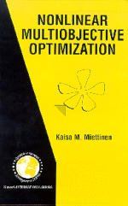
Contents
Nonlinear Multiobjective Optimization by
Kaisa M. Miettinen, Kluwer Academic Publishers, Boston, 1999
Concepts
Optimality
Methods (in 4 classes)
Tree diagram of methods
Graphical illustration
Applications
Concluding remarks

Slide 5
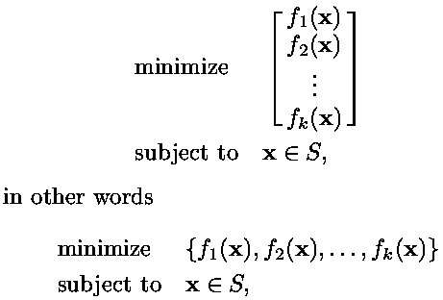
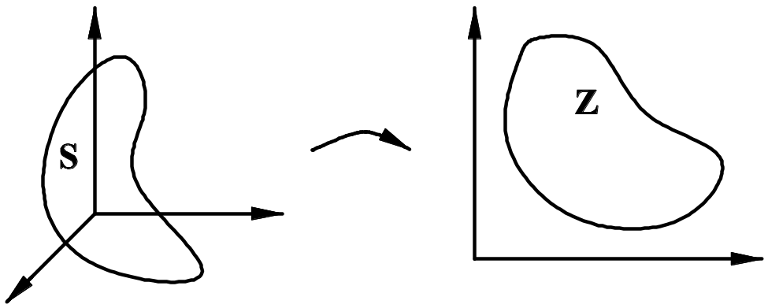
Concepts
We consider multiobjective optimization problems
where
f_{i} : R^{n}→R = objective function
k (≥ 2) = number of (conflicting) objective functions
x = decision vector (of n decision variables x_{i})
S ⊂ R^{n} = feasible region formed by constraint functions and
``minimize´´ = minimize the objective functions simultaneously

Slide 6
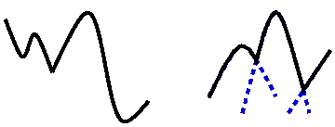
Concepts cont.
S consists of linear, nonlinear (equality and inequality) and box constraints (i.e. lower and upper bounds) for the variables
We denote objective function values by z_{i} = f_{i}(x)
z = (z₁,…, z_{k}) is an objective vector
Z ⊂ R^{k} denotes the image of S; feasible objective region. Thus z ∈ Z
Remember: maximize f_{i}(x) = - minimize - f_{i}(x)
We call a function nondifferentiable if it is locally Lipschitzian
Definition:
If all the (objective and constraint) functions are linear, the problem is linear (MOLP). If some functions are nonlinear, we have a nonlinear multiobjective optimization problem (MONLP). The problem is nondifferentiable if some functions are nondifferentiable and convex if all the objectives and S are convex
Notes:
Z = feasible objective region
nondifferentiable = not necessarily continuously differentiable but locally Lipschitzian

Slide 7
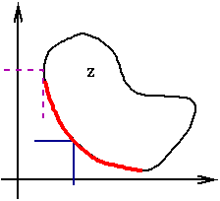
Optimality
Contradiction and possible incommensurability ⇒
Definition: A point x*∈ S is (globally) Pareto optimal (PO) if there does not exist another point x∈S such that f_{i}(x) ≤ f_{i}(x*) for all i=1,…,k and f_{j}(x) < f_{j}(x*) for at least one j. An objective vector z*∈Z is Pareto optimal if the corresponding point x* is Pareto optimal.
In other words, (z* - R^{k}₊\{0}) ∩ Z = ∅, that is, (z* - R^{k}₊) ∩ Z = z*
Pareto optimal solutions form (possibly nonconvex and non- connected) Pareto optimal set
Notes:
noninferior, efficient, nondominated

Slide 8
Theorems
Sawaragi, Nakayama, Tanino: We know that Pareto optimal solution(s) exist if
  the objective functions are lower semicontinuous and
  the feasible region is nonempty and compact
Karush-Kuhn-Tucker (KKT) (necessary and sufficient) optimality conditions can be formed as a natural extension to single objective optimization for both differentiable and nondifferentiable problems

Slide 9
Optimality cont.
Paying attention to the Pareto optimal set and forgetting other solutions is acceptable only if we know that no unexpressed or approximated objective functions are involved!
A point x*∈ S is locally Pareto optimal if it is Pareto optimal in some environment of x*
Global Pareto optimality ⇒ local Pareto optimality
Local PO ⇒ global PO, if S convex, f_{i}:s quasiconvex with at least one strictly quasiconvex f_{i}

Slide 10
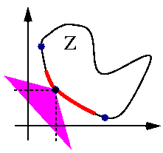
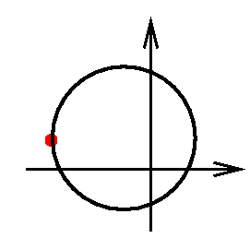
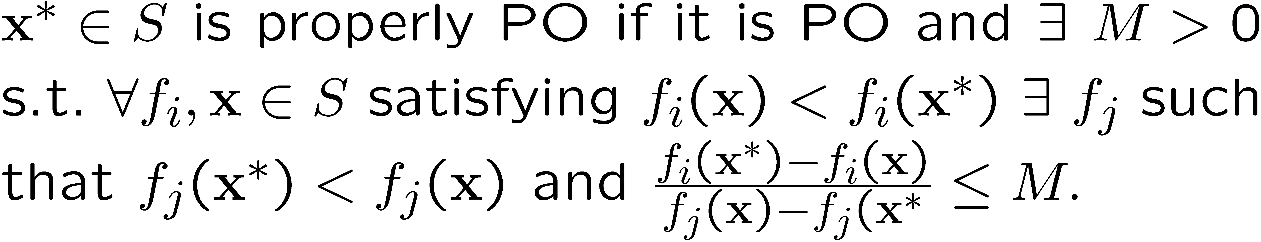
Optimality cont.
Definition: A point x*∈ S is weakly Pareto optimal if there does not exist another point x ∈ S such that f_{i}(x) < f_{i}(x*) for all i =1,…,k. That is,
(z* - int R^{k}₊) ∩ Z = ∅
Pareto optimal points can be properly or improperly PO
Properly PO: unbounded trade-offs are not allowed. Several definitions... Geoffrion:

Slide 11
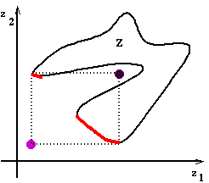
Concepts cont.
A decision maker (DM) is needed to identify a final Pareto optimal solution. (S)he has insight into the problem and can express preference relations
An analyst is responsible for the mathematical side
Solution process = finding a solution
Final solution = feasible PO solution satisfying the DM
Ranges of the PO set: ideal objective vector z and approximated nadir objective
vector z^{nad}
Ideal objective vector = individual
optima of each f_{i}
Utopian objective vector z is
strictly better than z
Nadir objective vector can be
approximated from a payoff table
but this is problematic

Slide 12
Concepts cont.
Value function U:R^{k}→R may represent preferences and sometimes DM is expected to be maximizing value (or utility)
If U(z¹) > U(z²) then the DM prefers z¹ to z². If U(z¹) = U(z²) then z¹ and z² are equally good (indifferent)
U is assumed to be strongly decreasing = less is preferred to more. Implicit U is often assumed in methods
Decision making can be thought of being based on either value maximization or satisficing
An objective vector containing the aspiration levels ž_{i} of the DM is called a reference point ž ∈R^{k}
Problems are usually solved by scalarization, where a real-valued objective function is formed (depending on parameters). Then, single objective optimizers can be used!

Slide 13


Trading off
Moving from one PO solution to another = trading off
Definition: Given x¹ and x² ∈ S, the ratio of change between f_{i} and f_{j} is
Λ_{ij} is a partial trade-off if f_{l}(x¹) = f_{l}(x²) for all l=1,…,k, l ≠i,j. If f_{l}(x¹) ≠ f_{l}(x²) for at least one l and l ≠ i,j, then Λ_{ij} is a total trade-off
Definition: Let d* be a feasible direction from x* ∈ S. The total trade-off rate along the direction d* is
If f_{l}(x*+αd*) = f_{l}(x*) ∀ l ≠i,j and ∀ 0 ≤α≤α*, then λ_{ij} is a partial trade-off rate

Slide 14

Marginal Rate of Substitution
Remember: x¹ and x² are indifferent if they are equally desirable to the DM
Definition: A marginal rate of substitution m_{ij}=m_{ij}(x*) is the amount of decrement in f_{i} that compensates the DM for one-unit increment in f_{j}, while all the other objectives remain unaltered
For continuously differentiable functions we have

Slide 15
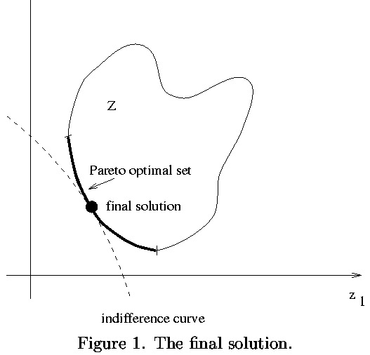
Final Solution
Notes:
point where indifference curve is tangent to the PO set.
negative of MRS = trade-off rates

Slide 16
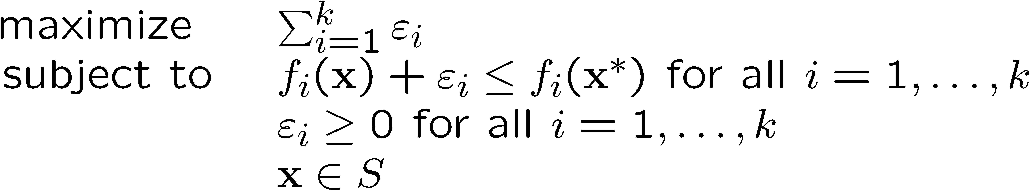
Testing Pareto Optimality (Benson)
x* is Pareto optimal if and only if
has an optimal objective function value 0. Otherwise, the solution obtained is PO
Notes:
- n + k variables

Slide 17
Methods
Solution = best possible compromise
Decision maker (DM) is responsible for final solution
Finding a Pareto optimal set or a representation of it = vector optimization
Method differ, for example, in: What information is exchanged, how scalarized
Two criteria
  Is the solution generated PO?
  Can any PO solution be found?
Classification
  according to the role of the DM:
    no-preference methods
    a posteriori methods
    a priori methods
    interactive methods
  based on the existence of a value function:
    ad hoc: U would not help
    non ad hoc: U helps

Slide 18
Methods cont.
No-preference methods
  Meth. of Global Criterion
A posteriori methods
  Weighting Method
  ε-Constraint Method
  Hybrid Method
  Method of Weighted Metrics
  Achievement Scalarizing Function Approach
A priori methods
  Value Function Method
  Lexicographic Ordering
  Goal Programming
Interactive methods
  Interactive Surrogate Worth Trade-Off Method
  Geoffrion-Dyer-Feinberg Method
  Tchebycheff Method
  Reference Point Method
  GUESS Method
  Satisficing Trade-Off Method
  Light Beam Search
  NIMBUS Method

Slide 19
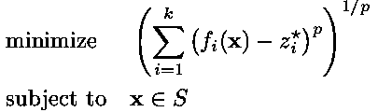

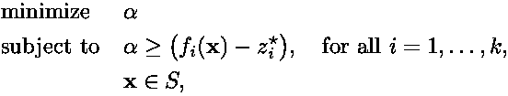
No-Preference Methods:
Method of Global Criterion (Yu, Zeleny)
Distance between z and Z is minimized by L_{p}-metric: if global ideal objective vector is known
Or by L∞-metric:
Differentiable form of the latter:

Slide 20
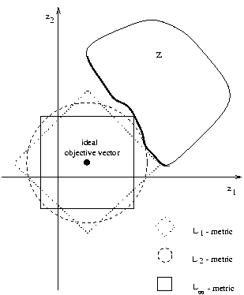
Method of Global Criterion cont.
The choice of p affects greatly the solution
Solution of the L_{p}-metric (p < ∞) is PO
Solution of the L∞-metric is weakly PO and the problem has at least one PO solution
Simple method (no special hopes are set)

Slide 21
A Posteriori Methods
Generate the PO set (or a part of it)
Present it to the DM
Let the DM select one
  Computationally expensive/difficult
  Hard to select from a set
How to display the alternatives? (Difficult to present the PO set)
Notes:
1. analyst, 2. DM

Slide 22
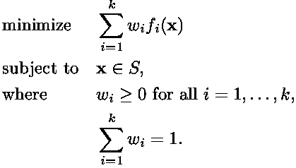
Weighting Method (Gass, Saaty)
Problem
Solution is weakly PO
Solution is PO if it is unique or w_{i} > 0 ∀ i
Convex problems: any PO solution can be found
Nonconvex problems: some of the PO solutions may fail to be found

Slide 23
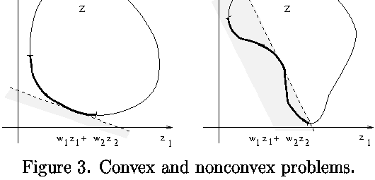
Weighting Method cont.
Weights are not easy to be understood (correlation, nonlinear affects). Small change in weights may change the solution dramatically
Evenly distributed weights do not produce an evenly distributed representation of the PO set

Slide 24
Why not Weighting Method
Selecting a wife (maximization problem):
 | beauty | cooking | house-wifery | tidi-ness
Mary | 1 | 10 | 10 | 10
Jane | 5 | 5 | 5 | 5
Carol | 10 | 1 | 1 | 1
Idea originally from Prof. Pekka Korhonen

Slide 25
Why not Weighting Method
Selecting a wife (maximization problem):
 | beauty | cooking | house-wifery | tidi-ness
Mary | 1 | 10 | 10 | 10
Jane | 5 | 5 | 5 | 5
Carol | 10 | 1 | 1 | 1
weights | 0.4 | 0.2 | 0.2 | 0.2

Slide 26
Why not Weighting Method
Selecting a wife (maximization problem):
 | beauty | cooking | house-wifery | tidi-ness | results
Mary | 1 | 10 | 10 | 10 | 6.4
Jane | 5 | 5 | 5 | 5 | 5
Carol | 10 | 1 | 1 | 1 | 4.6
weights | 0.4 | 0.2 | 0.2 | 0.2

Slide 27
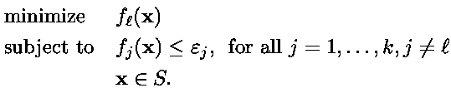
ε-Constraint Method (Haimes et al)
Problem
The solution is weakly Pareto optimal
x* is PO iff it is a solution when ε_{j} = f_{j}(x*) (i=1,…,k, j≠l) for all objectives to be minimized
A unique solution is PO
Any PO solution can be found
There may be difficulties in specifying upper bounds

Slide 28

Trade-Off Information
Let the feasible region be of the form S = {x ∈R^{n} | g(x) = (g₁(x),…, g_{m}(x)) ^{T} ≤ 0}
Lagrange function of the ε-constraint problem is
Under certain assumptions the coefficients λ_{j}= λ_{lj} are (partial or total) trade-off rates

Slide 29
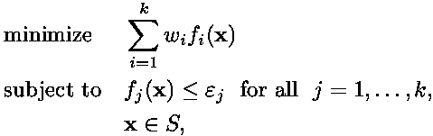
Hybrid Method (Wendell et al)
Combination: weighting + ε-constraint methods
Problem: where w_{i}>0 ∀ i=1,…,k
The solution is PO for any ε
Any PO solution can be found
The PO set can be found by solving the problem with methods for parametric constraints (where the parameter is ε). Thus, the weights do not have to be altered
Positive features of the two methods are combined
The specification of parameter values may be difficult
Notes:
Any PO solution can be found independently of the convexity of the problem and one does not have to solve several problems or think about uniqueness to guarantee the Pareto optimality of the solutions.

Slide 30
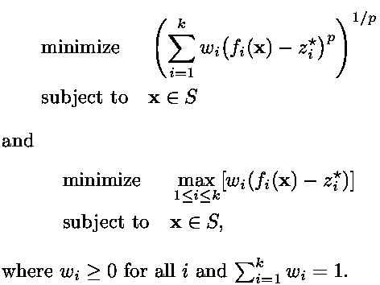
Method of Weighted Metrics (Zeleny)
Weighted metric formulations are
Absolute values may be needed

Slide 31
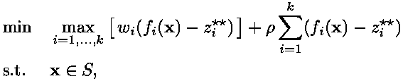
Method of Weighted Metrics cont.
If the solution is unique or the weights are positive, the solution of L_{p}-metric (p<∞) is PO
For positive weights, the solution of L∞-metric is weakly PO and ∃ at least one PO solution
Any PO solution can be found with the L∞-metric with positive weights if the reference point is utopian but some of the solutions may be weakly PO
All the PO solutions may not be found with p<∞
where ρ>0. This generates properly PO solutions and any properly PO solution can be found
Notes:
- Weakly PO solutions can be avoided by with the augmented problem.

Slide 32
Achievement Scalarizing Functions
Achievement (scalarizing) functions s_{ž}:Z→R, where ž is any reference point. In practice, we minimize in S
Definition: s_{ž} is strictly increasing if z_{i}¹< z_{i}² ∀ i=1,…,k ⇒ s_{ž}(z¹)< s_{ž}(z²). It is strongly increasing if z_{i}¹≤ z_{i}² for ∀ i and z_{j}¹< z_{j}² for some j ⇒ s_{ž}(z¹)< s_{ž}(z²)
s_{ž} is order-representing under certain assumptions if it is strictly increasing for any ž
s_{ž} is order-approximating under certain assumptions if it is strongly increasing for any ž
Order-representing s_{ž}: solution is weakly PO ∀ ž
Order-approximating s_{ž}: solution is PO ∀ ž
If s_{ž} is order-representing, any weakly PO or PO solution can be found. If s_{ž} is order-approximating any properly PO solution can be found
Notes:
For order approximating s_{ž} (with some ε1 and ε2), solution is PO for any ž.
For an order representing or order approximating function, we have s_{ž} (ž)=0.
The DM can obtain any arbitrary weakly PO or PO solution by moving the reference point only.

Slide 33


Achievement Functions cont. (Wierzbicki)
Example of order-representing functions:
where w is some fixed positive weighting vector
Example of order-approximating functions:
where w is as above and ρ>0 sufficiently small.
The DM can obtain any arbitrary (weakly) PO solution by moving the reference point only

Slide 34
Achievement Scalarizing Function: MOLP
z₂
z¹
ž²
ž¹
z²
z₁
Figure from Prof. Pekka Korhonen

Slide 35
Achievement Scalarizing Function: MONLP
z₂
B
A’
B’
A
C”
C’
C
z₁
Figure from Prof. Pekka Korhonen

Slide 36
Multiobjective Evolutionary Algorithms
Many different approaches
VEGA, RWGA, MOGA, NSGA II, DPGA, etc.
Goals: maintaining diversity and guaranteeing Pareto optimality – how to measure?
Special operators have been introduced, fitness evaluated in many different ways etc.
Problem: with real problems, it remains unknown how far the solutions generated are from the true PO solutions

Slide 37
NSGA II (Deb et al)
Includes elitism and explicit diversity-preserving mechanism
Nondominated sorting – fitness=nondomination level (1 is the best)
Combine parent and offspring populations (2N individuals) and perform nondominated sorting to identify different fronts F_{i} (i=1, 2, …)
Set new population = ;. Include fronts < N members.
Apply special procedure to include most widely spread solutions (until N solutions)
Create offspring population

Slide 38
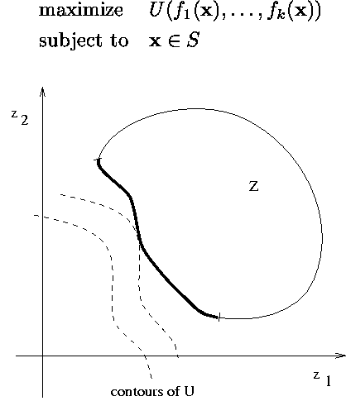
A Priori Methods
Value Function Method
(Keeney, Raiffa)
DM specifies hopes, preferences, opinions beforehand
DM does not necessarily know how realistic the hopes are (expectations may be too high)
Notes:
- contours of the value function

Slide 39
Variable, Objective and
Value Space
Multiple Criteria Design
Multiple Criteria Evaluation
X
Q
U
Figure from Prof. Pekka Korhonen

Slide 40
Value Function Method cont.
If U represents the global preference structure of the DM, the solution obtained is the ``best´´
The solution is PO if U is strongly decreasing
It is very difficult for the DM to specify the mathematical formulation of her/his U
Existence of U sets consistency and comparability requirements
Even if the explicit U was known, the DM may have doubts or change preferences
U can not represent intransitivity/incomparability
Implicit value functions are important for theoretical convergence results of many methods

Slide 41
Lexicographic Ordering
The DM must specify an absolute order of importance for objectives, i.e., f_{i} >>> f_{i+1}>>> ….
If the most important objective has a unique solution, stop. Otherwise, optimize the second most important objective such that the most important objective maintains its optimal value etc.
The solution is PO
Some people make decisions successively
Difficulty: specify the absolute order of importance
The method is robust. The less important objectives have very little chances to affect the final solution
Trading off is impossible
Notes:
The construction of the method is simple.
Impossible to allow a small increment of an important objective to be traded off with a great decrement of a less important objective.

Slide 42
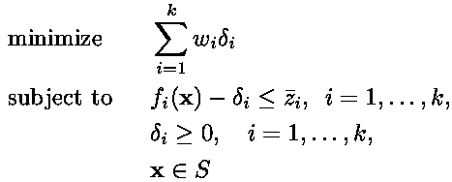
Goal Programming
(Charnes, Cooper)
The DM must specify an aspiration level ž_{i} for each objective function.
f_{i} & aspiration level = a goal. Deviations from aspiration levels are minimized (f_{i}(x) – δ_{i} = ž_{i})
The deviations can be represented as overachievements δ_{i} > 0
Weighted approach: with x and δ_{i} (i=1,…,k) as variables
  Weights from the DM

Slide 43
Goal Programming cont.
Lexicographic approach: the deviational variables are minimized lexicographically
Combination: a weighted sum of deviations is minimized in each priority class
The solution is Pareto optimal if the reference point is or the deviations are all positive
Goal programming is widely used for its simplicity
The solution may not be PO if the aspiration levels are not selected carefully
Specifying weights or lex. orderings may be difficult
Implicit assumption: it is equally easy for the DM to let something increase a little if (s)he has got little of it and if (s)he has got much of it
Notes:
- selecting aspiration levels carefully may be difficult.

Slide 44
Interactive Methods
A solution pattern is formed and repeated
Only some PO points are generated
Solution phases - loop:
  Computer: Initial solution(s)
  DM: evaluate preference information – stop?
  Computer: Generate solution(s)
Stop: DM is satisfied, tired or stopping rule fulfilled
DM can learn about the problem and interdependencies in it

Slide 45
Interactive Methods cont.
Most developed class of methods
DM needs time and interest for co-operation
DM has more confidence in the final solution
No global preference structure required
DM is not overloaded with information
DM can specify and correct preferences and selections as the solution process continues
Important aspects
  what is asked
  what is told
  how the problem is transformed
Notes:
DM has more confidence in the final solution because (s)he is involved in the solution process
no global preference structure is required

Slide 46
Interactive Surrogate Worth
Trade-Off (ISWT) Method (Chankong, Haimes)
Idea: Approximate (implicit) U by surrogate worth values using trade-offs of the ε-constraint method
Assumptions:
  continuously differentiable U is implicitly known
  functions are twice continuously differentiable
  S is compact and trade-off information is available
KKT multipliers λ_{li}> 0 ∀i are partial trade-off rates between f_{l} and f_{i}
For all i the DM is told: ``If the value of f_{l} is decreased by λ_{li}, the value of f_{i} is increased by one unit or vice versa while other values are unaltered´´
The DM must tell the desirability with an integer [10,-10] (or [2,-2]) called surrogate worth value
Notes:
- Thus, k-1 questions at each point.

Slide 47
ISWT Algorithm
Select f_{l} to be minimized and give upper bounds
Solve the ε-constraint problem.Trade-off information is obtained from the KKT-multipliers
Ask the opinions of the DM with respect to the trade-off rates at the current solution
If some stopping criterion is satisfied, stop. Otherwise, update the upper bounds of the objective functions with the help of the answers obtained in 3) and solve several ε-constraint problems to determine an appropriate step-size. Let the DM choose the most preferred alternative. Go to 3)
Notes:
stopping criteria: satisfaction of the DM or if trade-offs=marginal rates of substitution, that is, all the surrogate worth values = 0.

Slide 48
ISWT Method cont.
Thus: direction of the steepest ascent of U is approximated by the surrogate worth values
Non ad hoc method
DM must specify surrogate worth values and compare alternatives
The role of f_{l} is important and it should be chosen carefully
The DM must understand the meaning of trade-offs well
Easiness of comparison depends on k and the DM
It may be difficult for the DM to specify consistent surrogate worth values
All the solutions handled are Pareto optimal
Notes:
stopping criteria: satisfaction of the DM or if trade-offs=marginal rates of substitution, that is, all the surrogate worth values = 0.

Slide 49
Geoffrion-Dyer-Feinberg
(GDF) Method
Well-known method
Idea: Maximize the DM's (implicit) value function with a suitable (Frank-Wolfe) gradient method
Local approximations of the value function are made using marginal rates of substitution that the DM gives describing her/his preferences
Assumptions
  U is implicitly known, continuously differentiable and concave in S
  objectives are continuously differentiable
  S is convex and compact

Slide 50


GDF Method cont.
The gradient of U at x^{h}:
The direction of the gradient of U:
where m_{i} is the marginal rate of substitution involving f_{l} and f_{i} at x^{h} ∀ i, (i ≠ l). They are asked from the DM as such or using auxiliary procedures
Notes:
i:th partial derivative of U
gradient of f_i at x^h

Slide 51
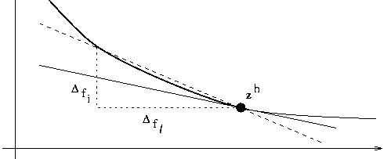
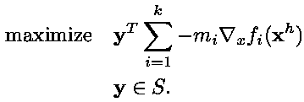
GDF Method cont.
Marginal rate substitution is the slope of the tangent
The direction of steepest ascent of U:
Step-size problem: How far to move (one variable). Present to the DM objective vectors with different values for t in f_{i}(x^{h}+td^{h}) (i=1,…,k) where d^{h}= y^{h} - x^{h}
Notes:
Figure 5. An approximating the marginal rate of subst.
After we have an estimate of the gradient of U we can use it to get the steepest ascent of U.
Now we know where to move and we must decide how far to move. We need estimates of U (not its gradient). We have one variable, the step--size.

Slide 52
GDF Algorithm
Ask the DM to select the reference function f_{l}. Choose a feasible starting point z¹. Set h=1
Ask the DM to specify k-1 marginal rates of substitution between f_{l} and other objectives at z^{h}
Solve the problem. Set the search direction d^{h}. If d^{h} = 0, stop
Determine with the help of the DM the appropriate step-size into the direction d^{h}. Denote the corresponding solution by z^{h+1}
Set h=h+1. If the DM wants to continue, go to 2). Otherwise, stop

Slide 53
GDF Method cont.
The role of the function f_{l} is significant
Non ad hoc method
DM must specify marginal rates of substitution and compare alternatives
The solutions to be compared are not necessarily Pareto optimal
It may be difficult for the DM to specify the marginal rates of substitution (consistency)
Theoretical soundness does not guarantee easiness of use

Slide 54
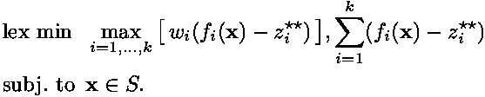
Tchebycheff Method (Steuer)
Idea: Interactive weighting space reduction method. Different solutions are generated with well dispersed weights. The weight space is reduced in the neighbourhood of the best solution
Assumptions: Utopian objective vector is available
Weighted distance (Tchebycheff metric) between the utopian objective vector and Z is minimized:
It guarantees Pareto optimality and any Pareto optimal solution can be found
Notes:
Possibility of producing weakly PO solutions is avoided by using the lexicographic problem

Slide 55
Tchebycheff Method cont.
At first, weights between [0,1] are generated
Iteratively, the upper and lower bounds of the weighting space are tightened
Algorithm
Specify number of alternatives P and number of iterations H. Construct z. Set h=1.
Form the current weighting vector space and generate 2P dispersed weighting vectors.
Solve the problem for each of the 2P weights.
Present the P most different of the objective vectors and let the DM choose the most preferred.
If h=H, stop. Otherwise, gather information for reducing the weight space, set h=h+1 and go to 2).

Slide 56
Tchebycheff Method cont.
Non ad hoc method
All the DM has to do is to compare several Pareto optimal objective vectors and select the most preferred one
The ease of the comparison depends on P and k
The discarded parts of the weighting vector space cannot be restored if the DM changes her/his mind
A great deal of calculation is needed at each iteration and many of the results are discarded
Parallel computing can be utilized

Slide 57

Reference Point Method (Wierzbicki)
Idea: To direct the search by reference points using achievement functions (no assumptions)
Algorithm:
Present information to the DM. Set h=1
Ask the DM to specify a reference point ž^{h}
Minimize ach. function. Present z^{h} to the DM
Calculate k other solutions with reference points
where d^{h}=||ž^{h} - z^{h}|| and e^{i} is the ith unit vector
If the DM can select the final solution, stop. Otherwise, ask the DM to specify ž^{h+1}. Set h=h+1 and go to 3)
Notes:
- the solution is PO or weakly PO depending on the achievement function.

Slide 58
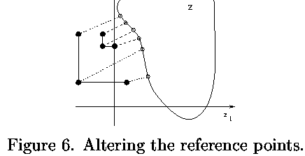
Reference Point Method cont.
Ad hoc method (or both)
DIDAS software
Easy for the DM to understand: (s)he has to specify aspiration levels and compare objective vectors
For nondifferentiable problems, as well
No consistency required
Easiness of comparison depends on the problem
No clear strategy to produce the final solution

Slide 59

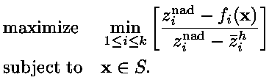
GUESS Method (Buchanan)
Idea: To make guesses ž^{h} and see what happens (The search procedure is not assisted)
Assumptions: z and z^{nad} are available
Maximize the min. weighted deviation from z^{nad}
Each f_{i}(x) is normalized ⇒ range is [0,1]
Problem:
Solution is weakly PO
Any PO solution can be found
Notes:
- Any PO solution can be found.

Slide 60
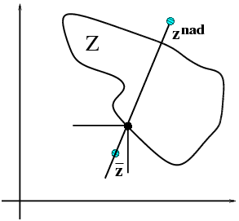
GUESS cont.

Slide 61
GUESS Algorithm
Present the ideal and the nadir objective vectors to the DM
Let the DM give upper or lower bounds to the objective functions if (s)he so desires. Update the problem, if necessary
Ask the DM to specify a reference point
Solve the problem
If the DM is satisfied, stop. Otherwise go to 2)
Notes:
Solve the problem to obtain a weakly Pareto optimal solution.
If the DM is satisfied with z^{h}, set it as a final solution and stop.

Slide 62
GUESS Method cont.
Ad hoc method
Simple to use
No specific assumptions are set on the behaviour or the preference structure of the DM. No consistency is required
Good performance in comparative evaluations
Works for nondifferentiable problems
No guidance in setting new aspiration levels
Optional upper/lower bounds are not checked
Relies on the availability of the nadir point
DMs are easily satisfied if there is a small difference between the reference point and the obtained solution

Slide 63
Satisficing Trade-Off Method (Nakayama et al)
Idea: To classify the objective functions:
  functions to be improved
  acceptable functions
  functions whose values can be relaxed
Assumptions
  functions are twice continuously differentiable
  trade-off information is available in the KKT multipliers
Aspiration levels from the DM, upper bounds from the KKT multipliers
Satisficing decision making is emphasized
Notes:
- objective and constraint functions are twice continuously differentiable

Slide 64
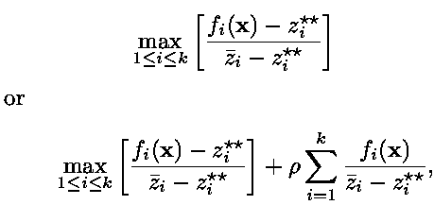
Satisficing Trade-Off Method cont.
Problem:
minimize
where ž^{h} > z and ρ>0
Partial trade-off rate information can be obtained from optimal KKT multipliers of the differentiable counterpart problem
Notes:
ž^{h} is a reference point, z is a utopian vector
ρ is some sufficiently small positive scalar.

Slide 65
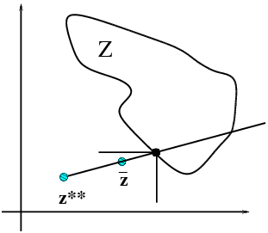
Satisficing Trade-off Method cont.

Slide 66
Satisficing Trade-Off Algorithm
Calculate z and get a starting solution.
Ask the DM to classify the objective functions into the three classes. If no improvements are desired, stop.
If trade-off rates are not available, ask the DM to specify aspiration levels and upper bounds. Otherwise, ask the DM to specify aspiration levels. Utilize automatic trade-off in specifying the upper bounds for the functions to be relaxed. Let the DM modify the calculated levels, if necessary.
Solve the problem. Go to 2).
Notes:
Current objective values are used as upper bounds in the third class.

Slide 67
Satisficing Trade-Off Method cont.
For linear and quadratic problems exact trade-off may be used to calculate how much objective values must be relaxed in order to stay in the PO set
Ad hoc method
Almost the same as the GUESS method if trade-off information is not available
The role of the DM is easy to understand: only reference points are used
Automatic or exact trade-off decrease burden on the DM
No consistency required
The DM is not supported
Notes:
- With exact trade-off, we do not have to solve the minimization problem.

Slide 68

Light Beam Search (Slowinski, Jaszkiewicz)
Idea: To combine the reference point idea and tools of multiattribute decision analysis (ELECTRE)
Minimize order-approximating achievement function (with an infeasible reference point)
Assumptions
  functions are continuously differentiable
  z and z^{nad} are available
  none of the objective functions is more important than all the others together
Notes:
Objective and the constraint functions must be cont. differentiable.

Slide 69
Light Beam Search cont.
Establish outranking relations between alternatives. One alternative outranks the other if it is at least as good as the latter
DM gives (for each objective) indifference thresholds = intervals where indifference prevails. Hesitation between indifference and preference = preference thresholds. A veto threshold prevents compensating poor values in some objectives
Additional alternatives near the current solution (based on the reference point) are generated so that they outrank the current one
No incomparable/indifferent solutions shown
Notes:
Frustration of the DM is avoided: no incomparable or indifferent solutions are shown.
A veto threshold prevents a good performance in some objectives from compensating for poor values on others.

Slide 70
Light Beam Search Algorithm
Get the best and the worst values of each f_{i} from the DM or calculate z and z^{nad}. Set z as reference point. Get indifference (preference and veto) thresholds.
Minimize the achievement function.
Calculate k PO additional alternatives and show them. If the DM wants to see alternatives between any two, set their difference as a search direction, take steps in that direction and project them. If desired, save the current solution.
The DM can revise the thresholds; then go to 3). If (s)he wants to change reference point, go to 2). If, (s)he wants to change the current solution, go to 3). If one of the alternatives is satisfactory, stop.
Notes:
If, the DM wants to select one of the alternatives displayed or saved as a current solution, go to 3).

Slide 71
Light Beam Search cont.
Ad hoc method
Versatile possibilities: specifying reference points, comparing alternatives and affecting the set of alternatives in different ways
Specifying different thresholds may be demanding. They are important
The thresholds are not assumed to be global
Thresholds should decrease the burden on the DM

Slide 72
NIMBUS Method
(Miettinen, Mäkelä)
Idea: move around Pareto optimal set
How can we support the learning process?
The DM should be able to direct the solution process
Goals: easiness of use
  What can we expect DMs to be able to say?
  No difficult questions
  Possibility to change one’s mind
Dealing with objective function values is understandable and straightforward
Notes:
- we must classify every objective function.

Slide 73
Classification in NIMBUS
Form of interaction: Classification of objective functions into up to 5 classes
Classification: desirable changes in the current PO objective function values f_{i}(x^{h})
Classes: functions f_{i} whose values
  should be decreased (i∈I<),
  should be decreased till some aspiration level ž_{i}^{h} < f_{i}(x^{h}) (i∈I≤),
  are satisfactory at the moment (i∈I⁼),
  are allowed to increase up till some upper bound ε_{i}^{h}>f_{i}(x^{h}) (i∈I>) and
  are allowed to change freely (i∈I◊)
Functions in I≤ are to be minimized only till the specified level
Assumption: ideal objective vector available
DM must be willing to give up something

Slide 74
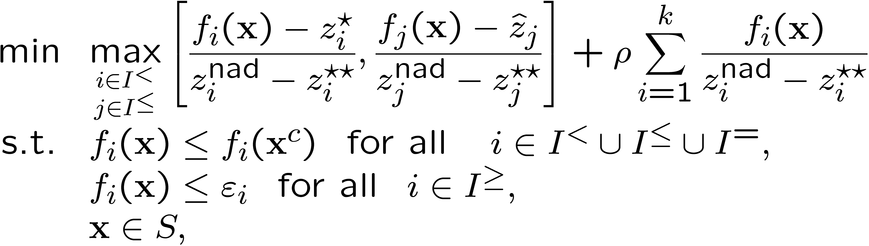
NIMBUS Method cont.
Problem
where ρ > 0
Solution properly PO. Any PO solution can be found
Any nondifferentiable single objective optimizer
Solution satisfies desires as well as possible – feedback of tradeoffs
Notes:
components of the ideal objective vector
DM must be ready to give up something in order to attain improvement for some other objectives.

Slide 75
Latest Development
Scalarization is important and contains preference information
Normally method developer selects one scalarization
But scalarizations based on same input give different solutions – Which one is the best? ⇒ Synchronous NIMBUS
Different solutions are obtained using different scalarizations
A reference point can be obtained from classification information
Show them to the DM and let her/him choose the best
In addition, intermediate solutions

Slide 76
NIMBUS Algorithm
Choose starting solution and project it to be PO.
Ask DM to classify the objectives and to specify related parameters. Solve 1-4 subproblems.
Present different solutions to DM.
If DM wants to save solutions, update database.
If DM does not want to see intermediate solutions, go to 7). Otherwise, ask DM to select the end points and the number of solutions.
Generate and project intermediate solutions. Go to 3).
Ask DM to choose the most preferred solution. If DM wants to continue, go to 2). Otherwise, stop.

Slide 77
NIMBUS Method cont.
Intermediate solutions between x^{h} and x’^{h}: f(x^{h}+t_{j}d^{h}), where d^{h}= x^{h}’- x^{h} and t_{j}=j/(P+1)
Only different solutions are shown
Search iteratively around the PO set – learning-oriented
Ad hoc method
Versatile possibilities for the DM: classification, comparison, extracting undesirable solutions
Does not depend entirely on how well the DM manages in classification. (S)he can e.g. specify loose upper bounds and get intermediate solutions
Works for nondifferentiable/nonconvex problems
No demanding questions are posed to the DM
Classification and comparison of alternatives are used in the extent the DM desires
No consistency is required
Notes:
Unlike with some other methods based on classification, the success of the solution process does not depend entirely on how well the DM manages in specifying the classification and the appropriate parameter values.

Slide 78
NIMBUS Software
Mainframe version
  Applicable for even large-scale problems
  No graphical interface ⇒ difficult to use
  Trouble in delivering updates
WWW-NIMBUS http://nimbus.it.jyu.fi/
  Centralized computing & distributed interface
  Graphical interface with illustrations via WWW
  Applicable for even large-scale problems
  Latest version is always available
  No special requirements for computers
    No computing capacity
    No compilers
  Available to any academic Internet user for free
  Nonsmooth local solver (proximal bundle)
  Global solver (GA with constraint-handling)
Notes:
Solving nonconvex problems necessitates global optimization!

Slide 79

WWW-NIMBUS since 1995
First, unique interactive system on the Internet
Personal username and password
Guests can visit but cannot save problems
Form-based or subroutine-based problem input
Even nonconvex and nondifferentiable problems, integer-valued variables
Symbolic (sub)differentiation
Graphical or form-based classification
Graphical visualization of alternatives
  Possibility to select different illustrations and alternatives to be illustrated
Tutorial and online help
Server computer in Jyväskylä
http://nimbus.it.jyu.fi/

Slide 80

WWW-NIMBUS Version 4.1
Synchronous algorithm
  Several scalarizing functions based on the same user input
Minimize/maximize objective functions
Linear/nonlinear inequality/equality and/or box constraints
Continuous or integer-valued variables
Nonsmooth local solver (proximal bundle) and global solver (GA with constraint-handling)
Two different constraint-handling methods available for GA (adaptive penalties & parameter free penalties)
Problem formulation and results available in a file
Possible to
  change solver at every iteration or change parameters
  edit/modify the current problem
  save different solutions and return to them (visualize, intermediate) using database

Slide 81


Slide 82


Slide 83
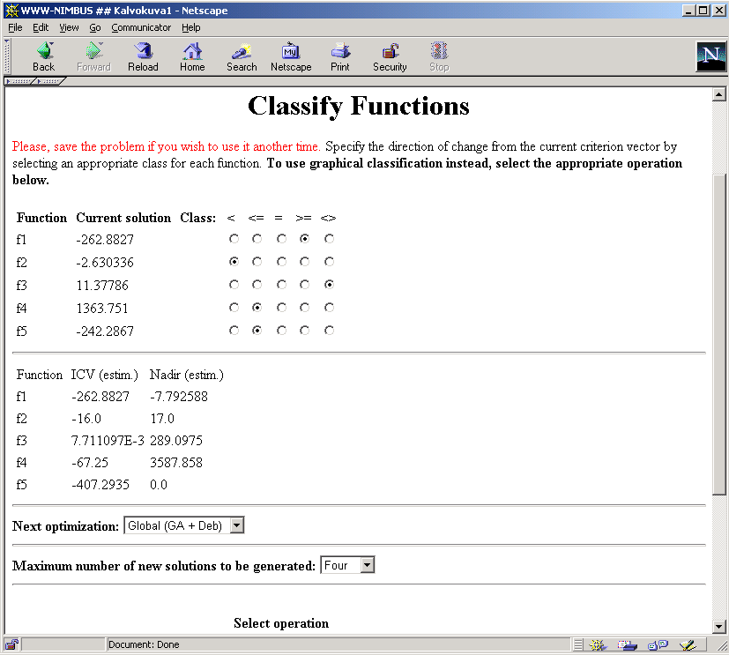

Slide 84
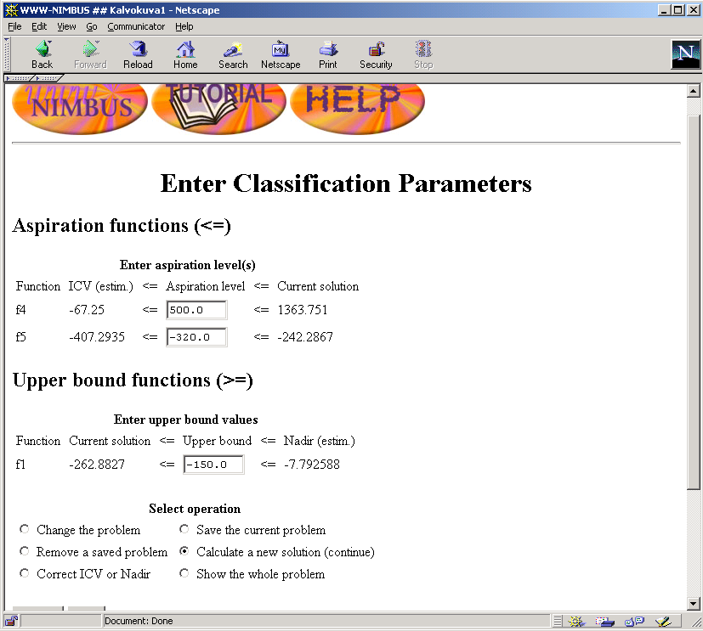

Slide 85
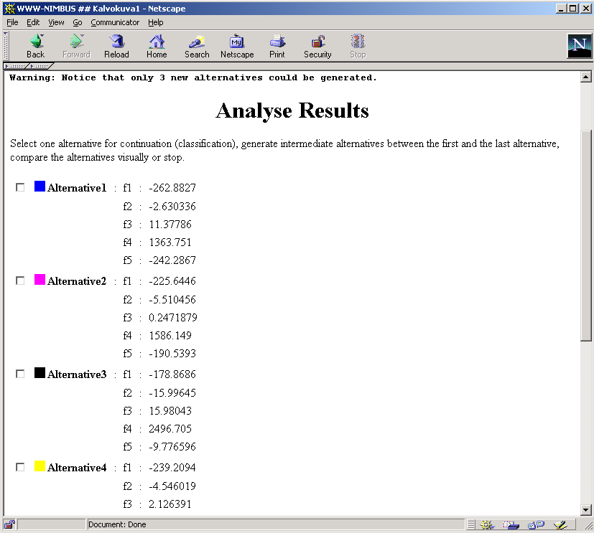

Slide 86
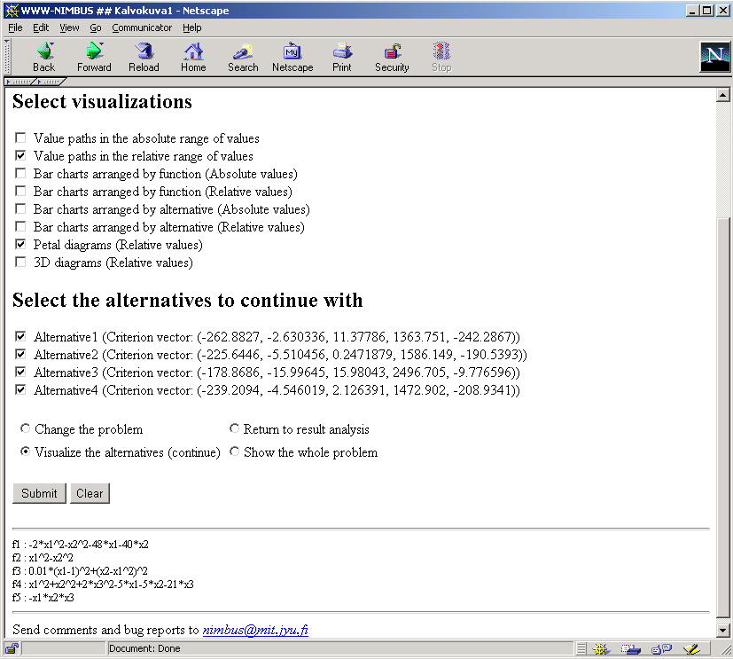

Slide 87
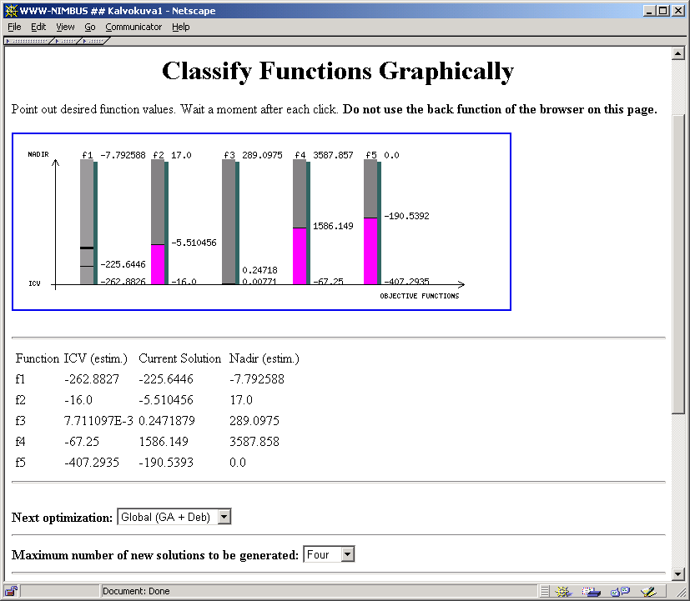

Slide 88
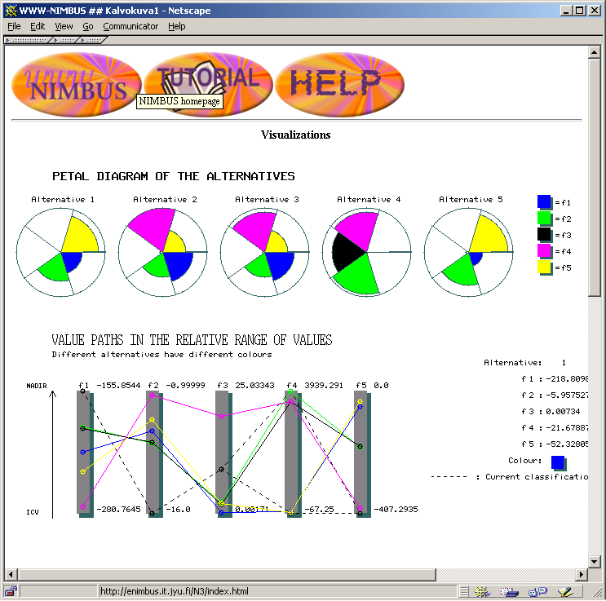

Slide 89
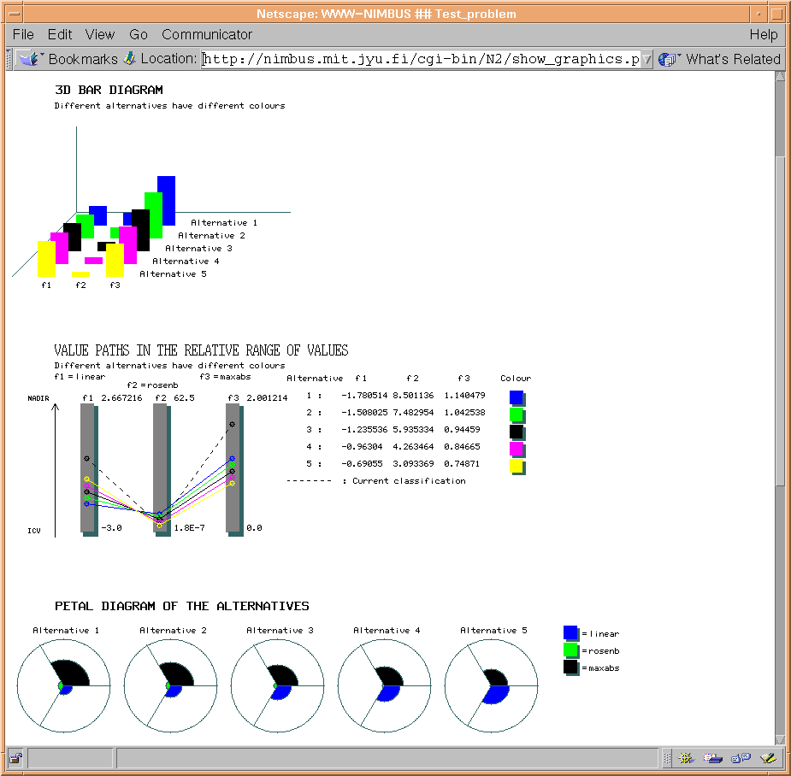

Slide 90
Summary: NIMBUS &
Interactive, classification-based method for continuous even nondifferentiable problems
  DM indicates desirable changes; no consistency required
  No demanding questions posed to the DM
  DM is assumed to have knowledge about the problem, no deep understanding of the optimization process required
  Does not depend entirely on how well the DM manages in classification. (S)he can e.g. specify loose upper bounds and get intermediate solutions
  Flexible and versatile: classification, comparison, extracting undesirable solutions are used in the extent the DM desires

Slide 91
Some Other Methods
Reference Direction approaches (Korhonen, Laakso, Narula et al)
  Steps are taken in the direction between reference point and current solution
Parameter Space Investigation (PSI) method (Statnikov, Matusov)
  For complicated nonlinear problems
  Upper and lower bounds required for functions
  PO set is approximated: generate randomly uniformly distributed points and drop a) those not satisfying bounds specified by the DM b) non-PO ones.
Feasible Goals Method (FGM) (Lotov et al)
  Pictures display rough approximations of Z and the PO set. Pictures are projections or slices.
  Z is approximated e.g. by a system of boxes. It contains only a small part of possible boxes, but approximates Z with a desired degree of accuracy
  DM identifies a preferred objective vector
Notes:
In FGM, the decision related to the selected feasible goal is identified and displayed.

Slide 92
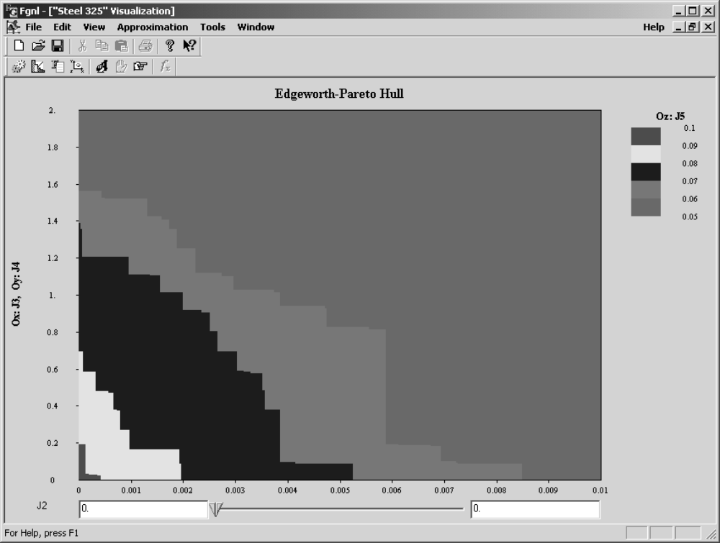
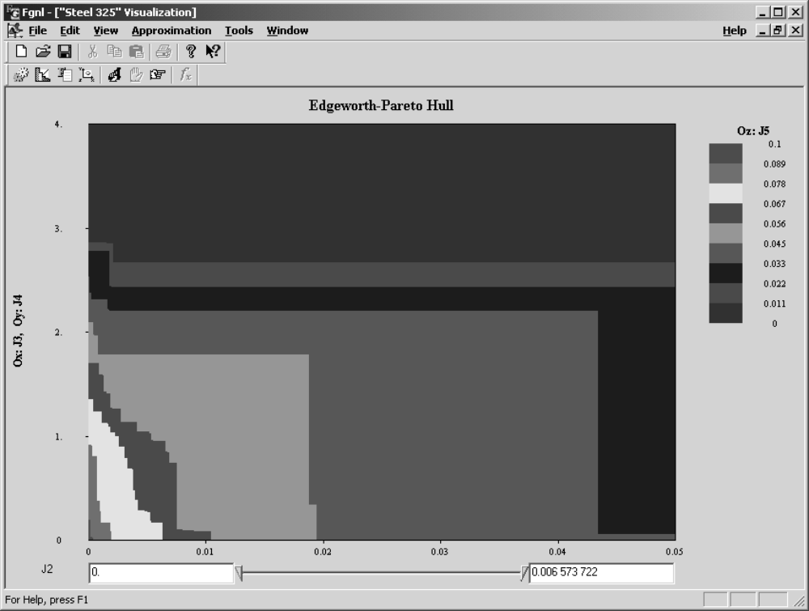

Slide 93
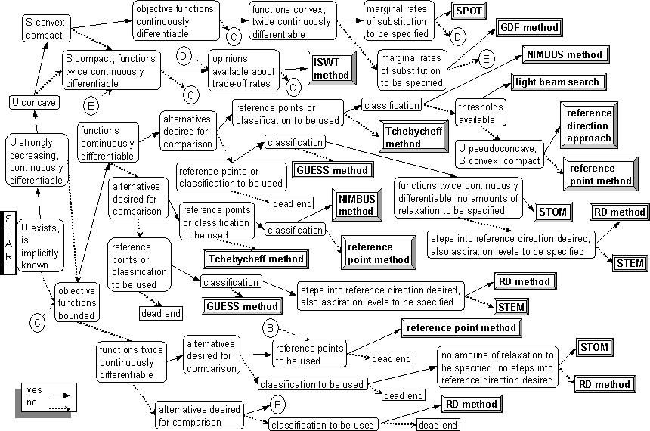
Tree Diagram of Methods

Slide 94
Graphical Illustration
The DM is often asked to compare several alternatives
Both discrete and continuous problems
  Some of interactive methods (GDF, ISWT, Tchebycheff, reference point method, light beam search, NIMBUS)
Illustration is difficult but important
  Should be easy to comprehend
  Important information should not be lost
  No unintentional information should be included
  Makes it easier to see essential similarities and differences

Slide 95
Graphical Illustration cont.
General-purpose illustration tools are not necessarily applicable
Surveys of different illustration possibilities are hard to find
Goal: deeper insight and understanding into the data
Human limitations (receive, process or remember large amounts of data)
Magical number
The more information, the less used ⇒ too much information should be avoided
Normalization: (value-ideal)/range

Slide 96
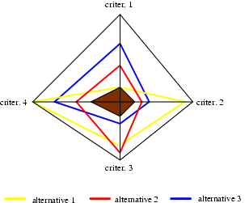
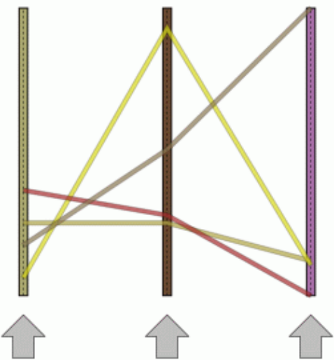
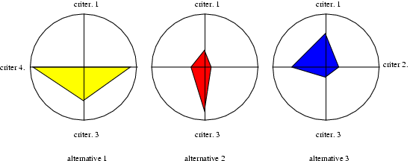
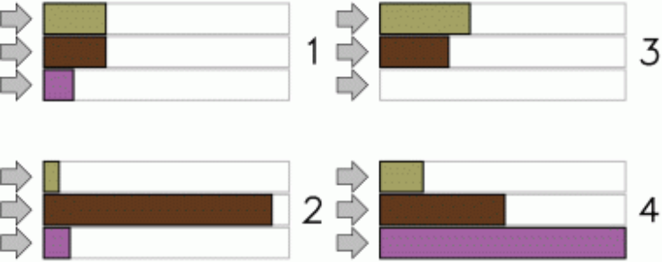
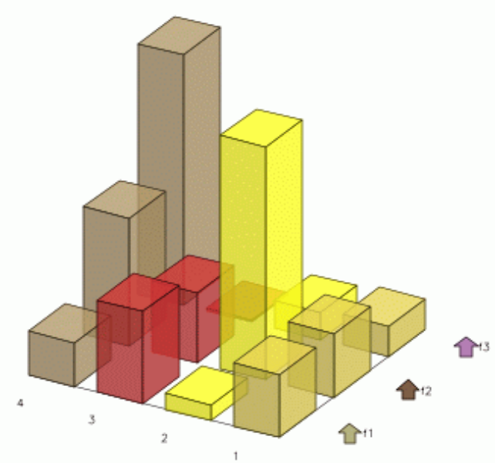
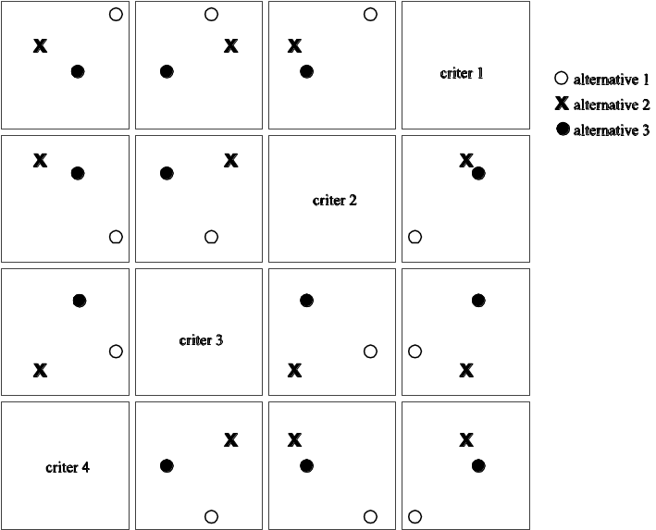
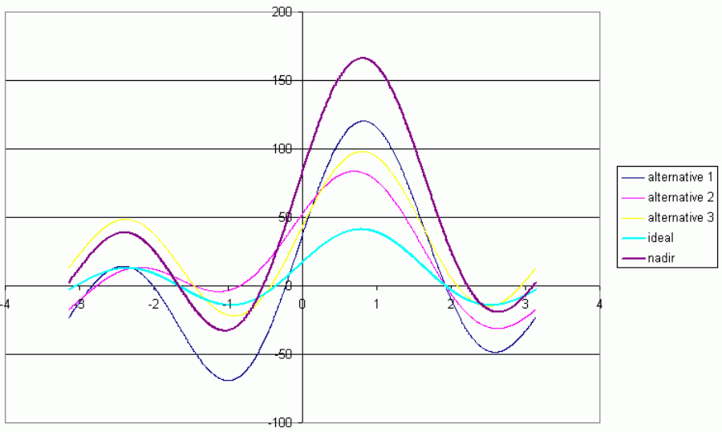
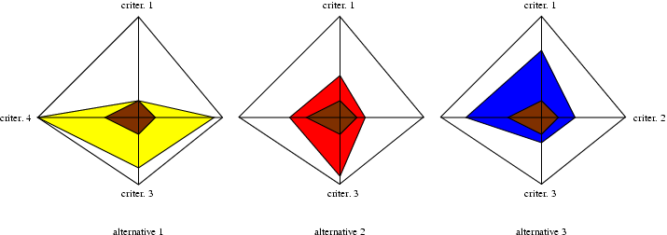
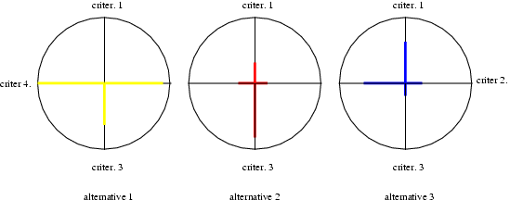



Different Illustrations
Value path
Bar chart
Star presentation (or line segments only)
Spider-web chart (or all in one polygon)
Petal diagram
Whisker plot
Iconic approaches (Chernoff’s faces)
Fourier series
Scatterplot matrix
Projection ideas (e.g. two largest principal components form a projection plane)
Ordinary tables!!!

Slide 97
Discussion
Graphs and tables complement each other
Tables – information acquisition
Graphs – relationships, viewed at a glance
Cognitive fit
Colours – good for association
New illustrations need time for training
Let the DM select the most preferred illustrations, select alternatives to be displayed, manipulate order of criteria etc.
Interaction
  Hide some pieces of information
  Highlight
DMs have different cognitive styles
Let the DM tailor the graphical display, if possible

Slide 98
Industrial Applications
  Continuous casting of steel
  Headbox design for paper machines
  Subprojects of the project
  NIMBUS – multiobjective optimization in product development
  financed by the National Technology Agency and industrial partners
    Paper machine design optimizing paper quality (Metso Paper Inc.)
    Process optimization with chemical process simulation (VTT Processes)
    Ultrasonic transducer design (Numerola Oy)

Slide 99

Continuous Casting of Steel
Originally, empty feasible region
Constraints into objectives
  Keep the surface temperature near a desired temperature
  Keep the surface temperature between some upper and lower bounds
  Avoid excessive cooling or reheating on the surface
  Restrict the length of the liquid pool
  Avoid too low temperatures at the yield point
Minimize constraint violations

Slide 100


Paper Machine
100-150 meters long, width up to 11 meters
Four main components
  headbox
  former
  press
  drying
In addition, finishing
Objectives
  qualitative properties
  save energy
  use cheaper fillers and fibres
  produce as much as possible
  save environment

Slide 101
Headbox Design
Headbox is located at the wet end
Distributes furnish (wood fibres, filler clays, chemicals, water) on a moving wire (former) so that outlet jet has controlled
  concentration, thickness
  velocity in machine and cross direction
  turbulence
Flow properties affect the quality of paper. 3 objective functions
  basis weight
  fibre orientation
  machine direction velocity component
Headbox outlet height control
PDE-based models: depth-averaged Navier-Stokes equations for flows with a model for fibre consistency
Notes:
Metso Paper – one of leading paper machine suppliers
Paper machine:
100-200 m long, 10 m wide
100 km/h
control basis weight with 0.1 g/m²
100 million euros
fibre suspension mixed in water
wood fibres + water pumped to headbox
even layer
Phenomena (fluid dynamics) in the headbox affect the quality of paper
solid concentration 1% in the headbox
rest of the machine takes care of removing water

Slide 102

Headbox Design cont.
Earlier
Weighting method
  how to select the weights?
  how to vary the weights?
Genetic algorithm
  two objectives
  computational burden
First model with NIMBUS
  turned out: model did not represent the actual goals
  thus, it was difficult for the DM to specify preference information
Notes:
header, equalizing chamber, second tube bundle, contracting channel, velocity increases 25-30 m/s
flow turns 90 degr. MD in header
goal: equal flow rate accorss the machine width into small pipes -> good quality
Domain decomposition into 3 subdomains
Homogenization of the tube bundles
Depth-averaging (3D⇨2D)

Slide 103
Optimizing Paper Quality
Consider paper making process and paper machine as a whole
Paper making process is complex and includes several different phases taken care of by different components of the paper machine
We have (PDE-based or statistical) submodels for
  different components
  different qualitative properties
We connect submodels to get chains of them to form model-based optimization problems where a simulation model constitutes a virtual paper machine
Dynamic simulation model generation
Optimal paper machine design is important because, e.g., 1% increase in production means about 1 million euros value of saleable production

Slide 104
Example with 4 Objectives
Problem related to paper making in four main parts of paper machine: headbox, former, press and drying
4 objective functions
  fiber orientation angle
  basis weight
  tensile strength ratio
  normalized β-formation
  all of the form: deviations between simulated and goal profiles in the cross-machine direction
22 decision variables
  for example, slice opening, under pressures of rolls and press nip loads
Simulation model contains 15 submodels
Interactive solution process with WWW-NIMBUS
  underlying single objective optimizer: genetic algorithms

Slide 105

Problem Formulation and Solution Process with NIMBUS
where
  x is the vector of decision variables
  B_{i} is the i^{th} submodel in the simulation model, i.e., in the state system
  q_{i} is the output of B_{i}, i.e., i^{th} state vector
Expert DM made 3 classifications and produced intermediate solutions once (between solutions of different scalarizations)

Slide 106




Solution Process cont.
Black: goal profile, green: initial profile, red: final profile

Slide 107
Example with 5 Objectives
Problem includes also the finishing part
5 objective functions describing qualitative properties of the finished paper
  min PPS 10-properties (roughness) on top and bottom sides of paper
  max gloss of paper on top and bottom sides
  max final moisture
22 decision variables
  typical controls of paper machine including controls in the finishing part of machine
Simulation model contains 21 submodels
Interactive solution process with WWW-NIMBUS
  DM wanted to improve PPS 10-properties and have equal quality on the top and bottom sides of paper
  underlying single objective optimizer: proximal bundle method

Slide 108
Solution Process with NIMBUS
4 classifications and intermediate solutions generated once
DM learned about the conflicting qualitative properties
DM obtained new insight into complex and conflicting phenomena
DM could consider several objectives simultaneously
DM found the method easy to use
DM found a satisfactory solution and was convinced of its goodness
Objective function | min/max | Initial solution | 2. class. solution | Interm. solution | 3. class. solution | Final solution
PPS 10 top | min | 1.20 | 0.82 | 0.94 | 1.24 | 1.01
PPS 10 bottom | min | 1.29 | 1.03 | 1.15 | 1.27 | 1.04
Gloss top | max | 1.09 | 1.09 | 1.09 | 1.05 | 1.07
Gloss bottom | max | 0.99 | 1.14 | 1.06 | 0.95 | 1.09
Final moisture | max | 1.88 | 0.1 | 0.89 | 1.93 | 1.19

Slide 109
Process Simulation
Process simulation is widely used in chemical process design
Optimization problems arising from process simulation (related to chemical processes that can be mathematically modelled)
Solutions generated must satisfy a mathematical model of a process
So far, no interactive process design tool has existed that could have handled multiple objectives
BALAS process simulator (by VTT Processes) is used to provide function values via simulation and combined with WWW-NIMBUS ) interactive process optimization

Slide 110


Heat Recovery System
Heat recovery system design for process water system of a paper mill
Main trade-off between running costs, i.e., energy and investment costs
4 objective functions
  steam needed for heating water for summer conditions
  steam needed for heating water for winter conditions
  estimation of area for heat exchangers
  amount of cooling or heating needed for effluent
3 decision variables
  area of the effluent heat exchanger
  approach temperatures of the dryer exhaust heat exchangers for both summer and winter operations
Notes:
y in R^{n} are iteration variables
F: R^{p} → R^{p} is the system of error functions for y
F=0 means that the process is in a steady-state

Slide 111
Ultrasonic Transducer
Optimal shape design problem to find good dimensions (shape) for a cylinder-shaped ultrasonic transducer
Sound is generated with Langevin-type piezo-ceramic piled elements
Besides piezo elements, transducer package contains head mass of steel (front), tail mass of aluminium (back) and screw located in the middle axis in the back of the transducer
Vibrations of the structure are modelled with PDEs
Simulation model: so-called axisymmetric piezo-equation, i.e., a PDE describing displacements of materials, electric field in the piezo-material and interrelationships
Axisymmetric structure ) geometry as a two-dimensional cross-section (a half of it). Separate density, Poisson ratio, modulus of elasticity and relative permittivity for each type of material

Slide 112

Transducer cont.
3 objectives
  maximal sound output (i.e. vibration of tip)
  minimal vibration (of fixing part) casing
  minimal electric impedance
2 variables: length of the head mass l and radius of tip r
Combine Numerrin (by Numerola), a FEM-simulation software package with WWW-NIMBUS to be able to handle objective functions defined by PDE-based simulation models (with automatic differentiation)
l
r

Slide 113
Conclusions
Multiobjective optimization problems can be solved!
Multiobjective optimization gives new insight into problems with conflicting criteria
No extra simplification is needed (e.g., in modelling)
A large variety of methods; none of them is superior
Selecting a method = a problem with multiple criteria. Pay attention to features of the problem, opinions of the DM, practical applicability
Interactive approach good if DM can participate
Important: user-friendliness
Methods should support learning
(Sometimes special methods for special problems)

Slide 114

International Society on Multiple Criteria Decision Making
More than 1400 members from about 90 countries
No membership fees at the moment
Newsletter once a year
International Conferences organized every two years
http://www.terry.uga.edu/mcdm/
Contact me if you wish to join

Slide 115
Further Links
Suomen Operaatiotutkimusseura ry http://www.optimointi.fi
Collection of links related to optimization, operations research, software, journals, conferences etc. http://www.mit.jyu.fi/miettine/lista.html

